Slide 1
Meetings - (Imp)

Slide 2
Meeting
Coming together of two or more people ( planned or unplanned)
Gathering of a group of people belonging to an office or organization for discussion and making decisions
Conducting and participating => effective mass communication
Deft definition : Meeting is a gathering in which people waste hours and keep minutes
Why meetings? ( Read from page 316-317)

Slide 3
Process
Notification 1 week before
To all the members concerned
With clear agenda of discussion

Slide 4
Chairmanship
Controller,
Conductor and ,
Director of meeting
Participants

Slide 5
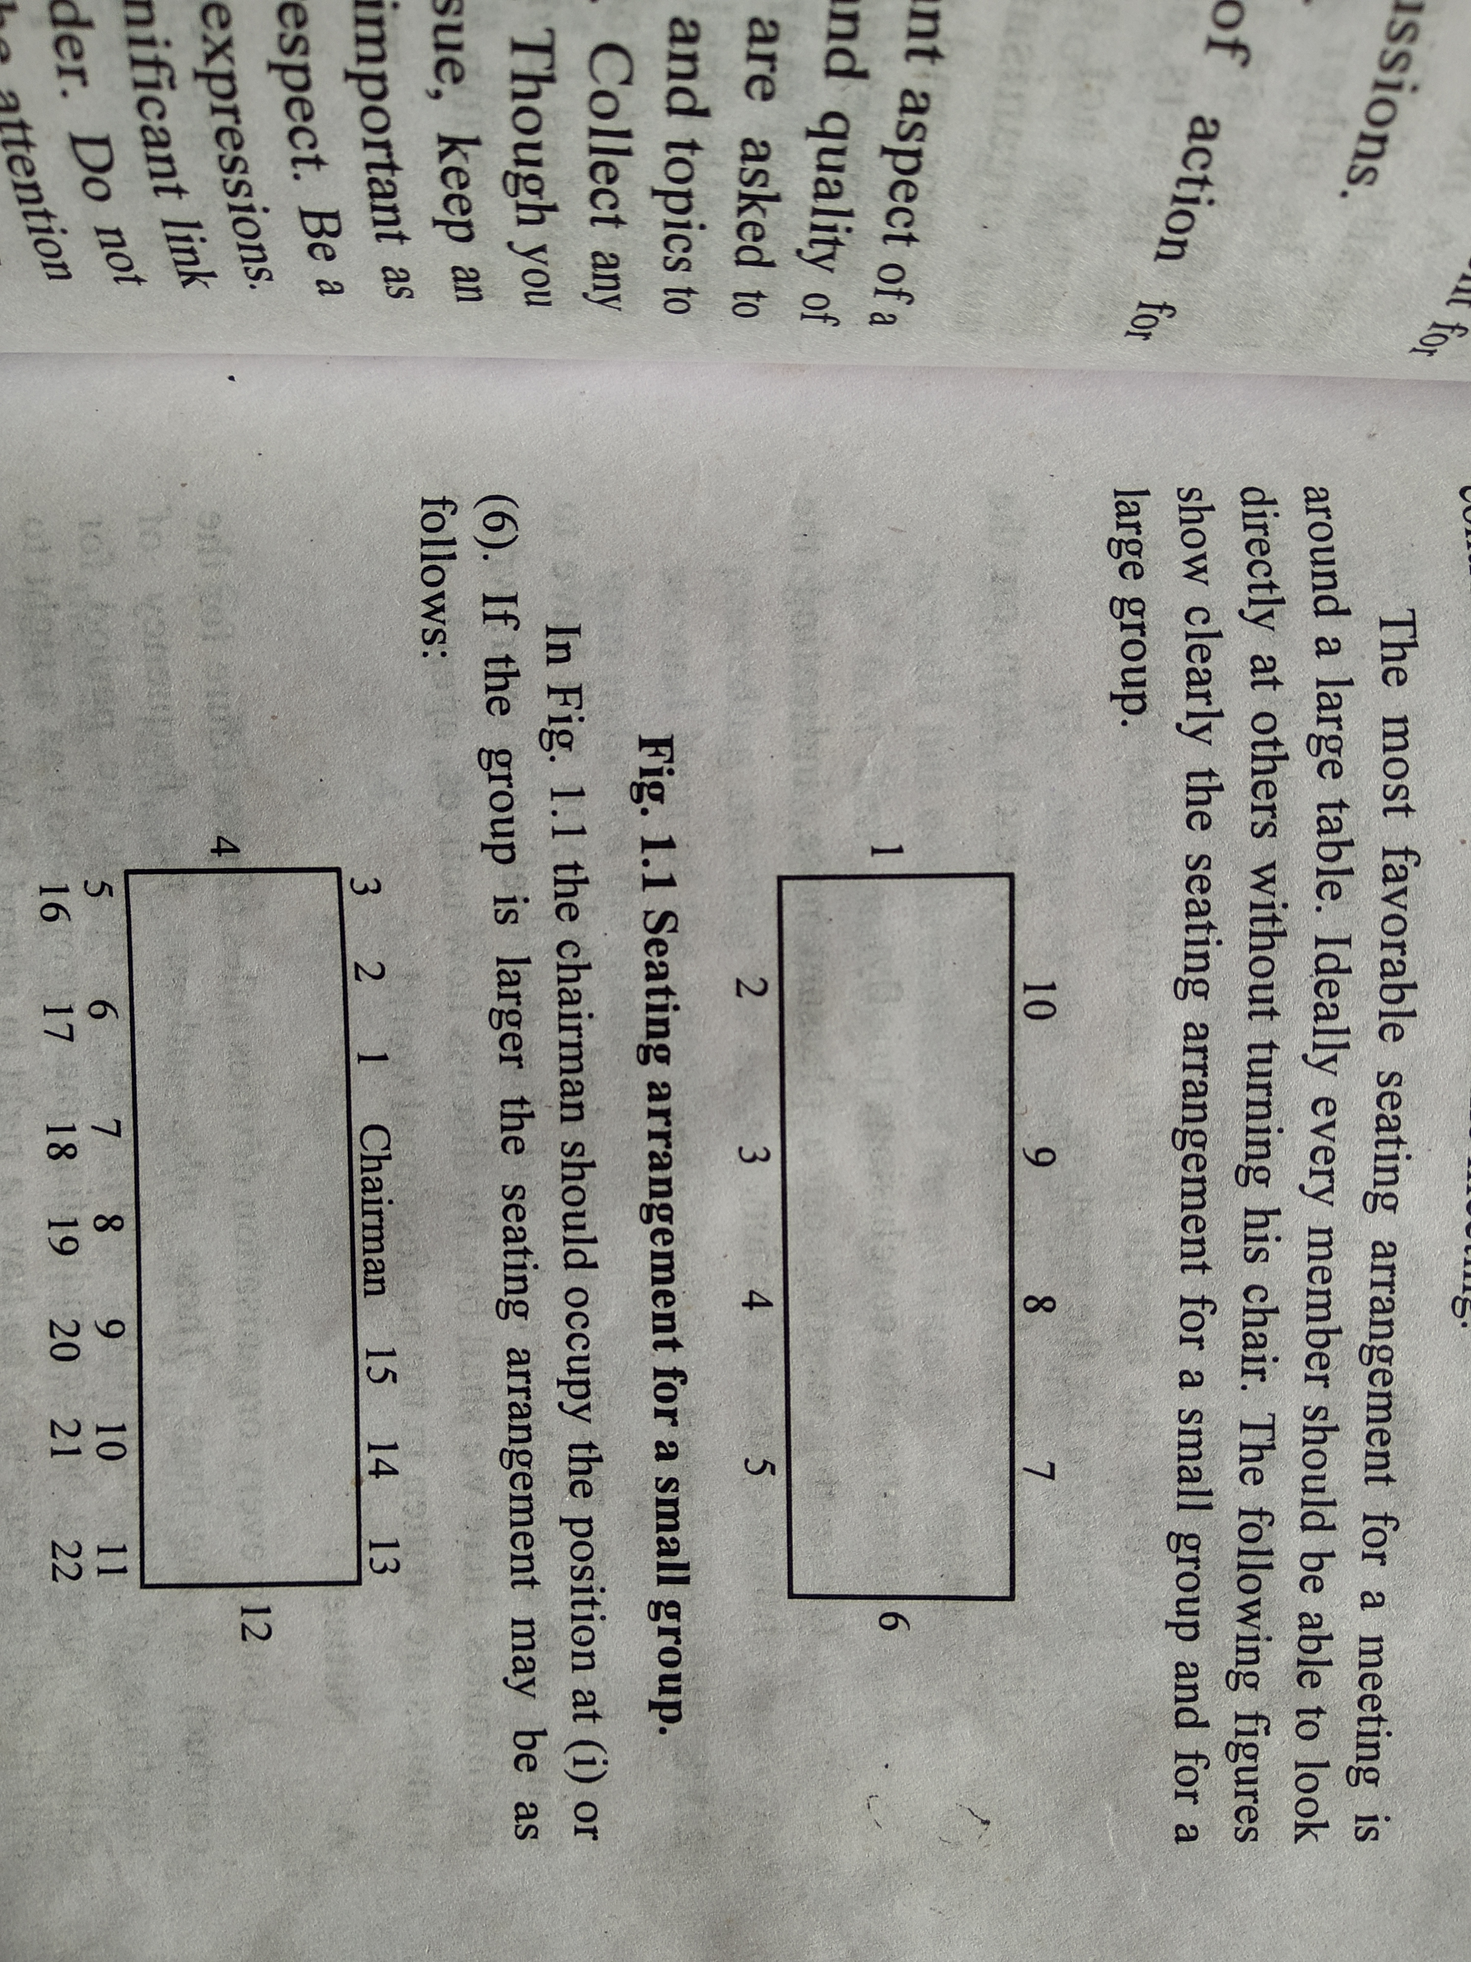
Seating Arrangement

Slide 6
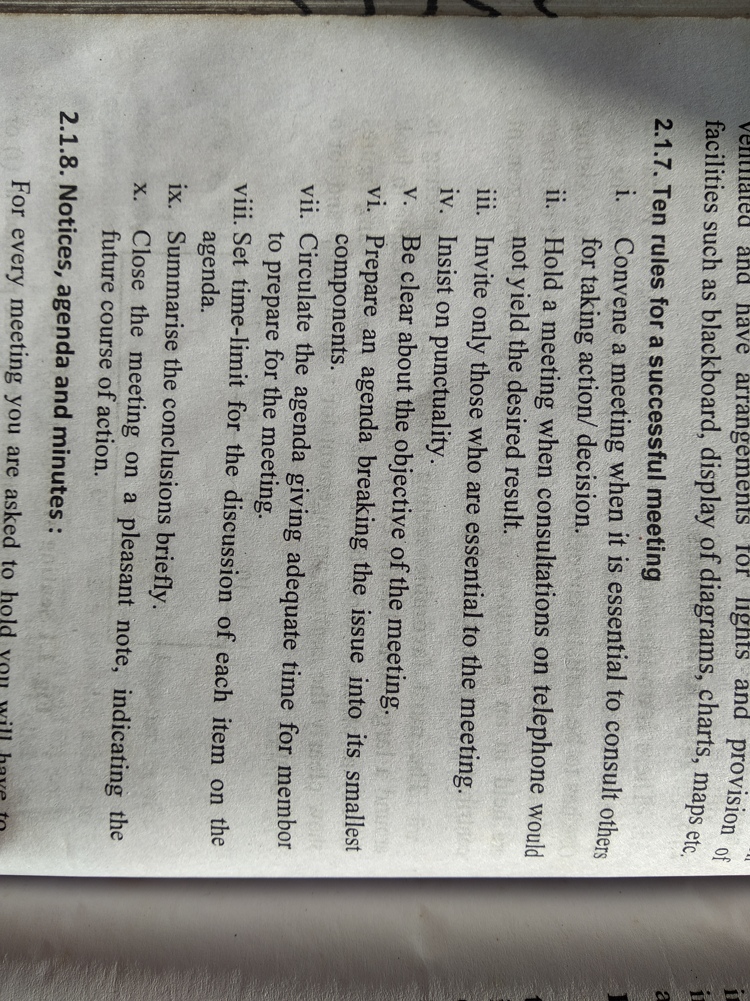

Slide 7
Notice + Agenda
Sent by secretary
To all the members
Time, day, date, month, year, place/venue (TDDMYP)
Frequency of the meeting
Agenda included or attached

Slide 8
Contd..
In the increasing order of importance
With frequency of the meeting and number of agenda
Minutes of the previous meetings
--------------------------------------
--------------------------------------
Any other matter with the permission of the chairman

Slide 9
Exercise :- 327 Q.1 (Sample notice)
Engineering Association Working Committee
Pokhara, Kaski
2nd November, 2020
Working committee meeting notice
The 6th meeting of the Engineering Association Working Committee is going to be held at 8:00am, Friday, 9th November ,2020 in the office hall. Please make it convenient to attend the same. The agenda is given below

Slide 10
6.01 Minutes of the previous meeting
6.02 Renewal of membership
6.03 New membership
6.04 Organization of a seminar
6.05 Any other matter with the permission of the chairman
Sheetal Pradhan
(Secretary)
cc- All the members

Slide 11
Minutes
Simple, clear, straight forward language, impersonal (mostly passive)
Name and address of the Organization
Minutes
5.01 Minutes of the previous meeting
_
_
5.02.....................

Slide 12
Exercises - Meeting
Precision Machine Tool Co. Ltd
Janakpur
Minutes of the tenth meeting of the Board of Directors held at 2:00 pm on Sunday 1st November 2020 in the company's meeting hall.
Members Present:
Mr. G. Sharma (Chairman)
Mr. P. Shakya (Member)
Mr. N. Khatri (Member)
Mr. Prashant Lekhak (Secretary)
Member absent :
Mr. K. Karan (Member)

Slide 13
10.01 . Minutes of the previous meeting
The minutes of the 9th meeting of the Board of Directors held on the 3rd October were read, adopted and signed by the chairman.
10.02. Tenders of the new premises
The tenders which were already requested for the new premises of the company were collected and the tender tabled by
Mr. Sahadev Shakya was approved after study and discussion.
10.03. Creation of five posts of travelling salesman
As the company required five more travelling salesmen, the posts were created for five major marketing points of the country and a decision to advertise for the posts was made.

Slide 14
10.04. Opening branch offices in Biratnagar, Birjung, and Pokhara
For the purpose of better and more effective administration, the meeting decided to open the company's branch offices in three major cities of the country - Biratnagar, Birjung, and Pokhara. It was also decided that the administrative personnel to work in the new branches would be the matter of discussion in the next meeting.
Since no other matter of discussion was raised, the meeting concluded with a vote of thanks to the chairman.
G. Shakya Prashant Lekhak
(Chairman) (Secretary)
Note: Follow the format on pages 323,324,325

Slide 15
cc – carbon copy (similar copy sent to other individuals, groups or organization
encl – enclosure (other documents attached with the main letter/document)
NB – Nota Bene (indication of something important)

Slide 16


Thank You

